Slide 1

BLOCK CODING LEARNER
Session 48
Artificial Intelligence

Slide 2


Recall…
What we have learnt in last session
What challenges you are facing

Slide 3

Artificial Intelligence…
We will Learn today:
Understanding AI?
Machine Learning
AI Training?
AI Applications

Slide 4
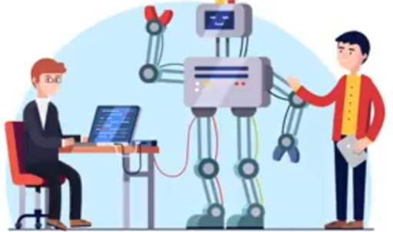
Understanding Artificial Intelligence…
Hey ! What am I?
You are what we call ‘Artificial Intelligence’

Slide 5
Understanding Artificial Intelligence…
Thanks! Any Task you want me to do for you?
Get me a cup of Coffee?

Slide 6
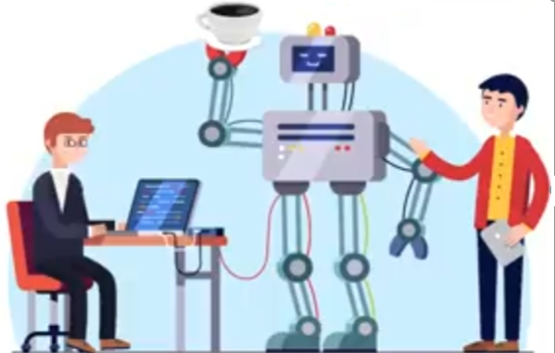
Understanding Artificial Intelligence…
Here you go !

Slide 7





Brief History of Artificial Intelligence…
1956
1969
1997
2002
2005-2018
The World ‘Artificial Intelligence’ coined by John Mc Carthy
‘Shakey’ was the First General Purpose Mobile Robot Built
Supercomputer ‘Deep Blue’ was designed which defeated the world chess champion in a game
First Commercially successful Robotic vacuum cleaner created
Speech Recognition,RPA,Dancing Robots, Smart Homes and many more to come from AI

Slide 8
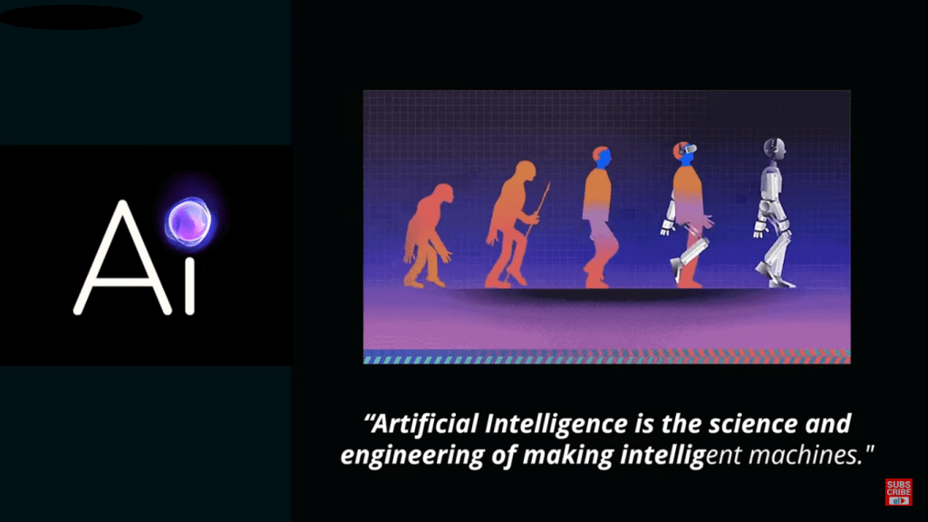
What is AI?

Slide 9
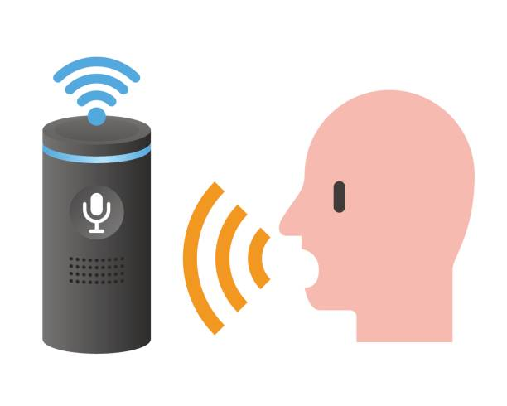
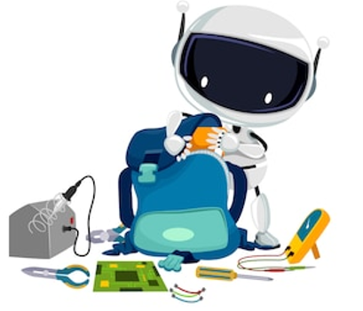
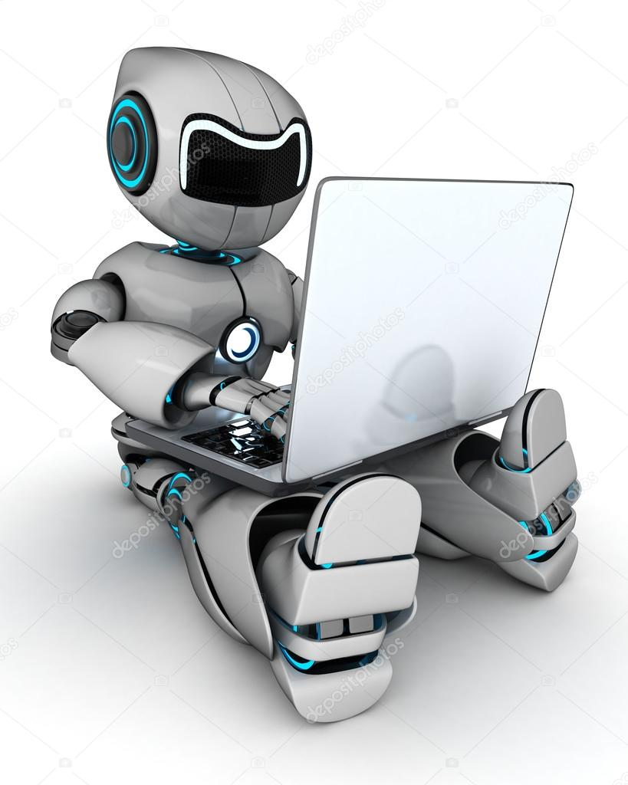
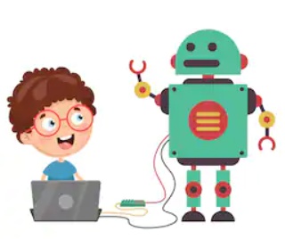
What is AI?
AI is a form of Computer Science used to create Intelligent machines that can recognize Human Speech, Objects, Can Learn, Plan and Solve Problems like Humans
Speech Recognition
Object Detection
Plan and Approach for future tasks to be done
Problem Solving

Slide 10





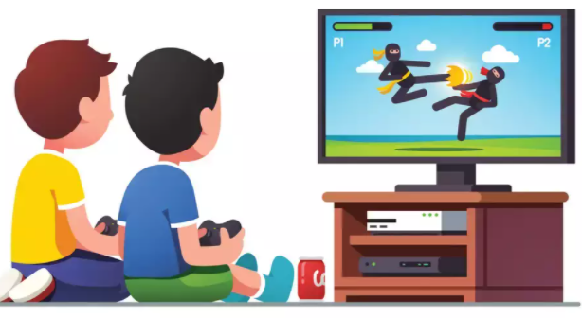
Applications Of AI…
Smart Phones
Cars
Social Media
Video Games
Banks
Surveillances

Slide 11
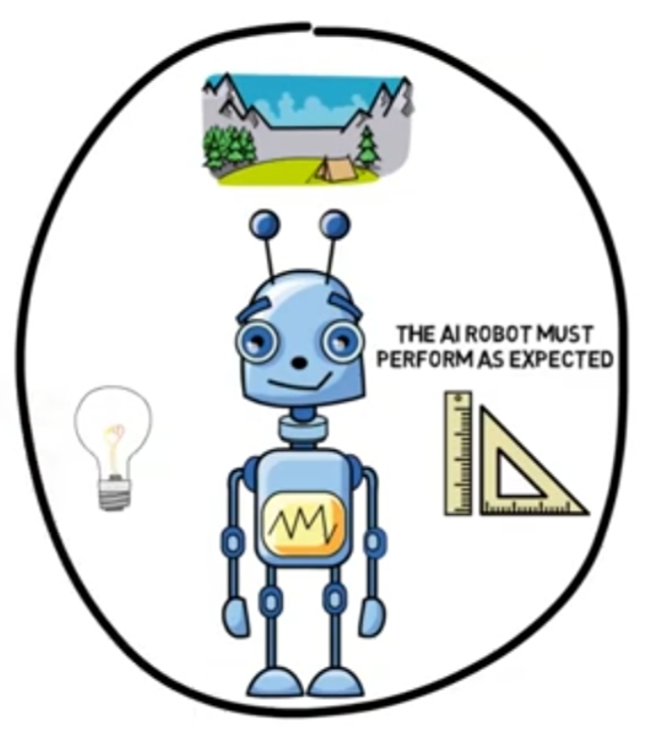
What Does AI Do at its Core?
Generalized
Learning

Slide 12
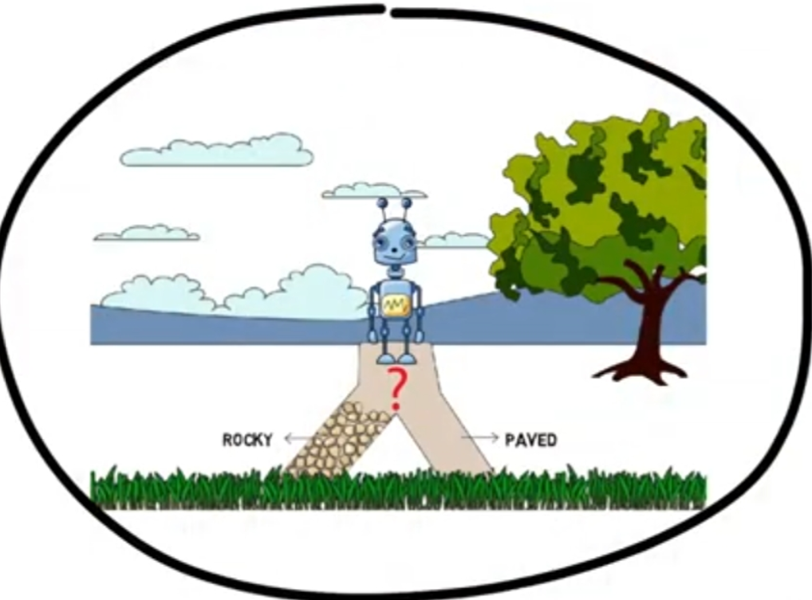
What Does AI Do at its Core?
Reasoning
Ability

Slide 13
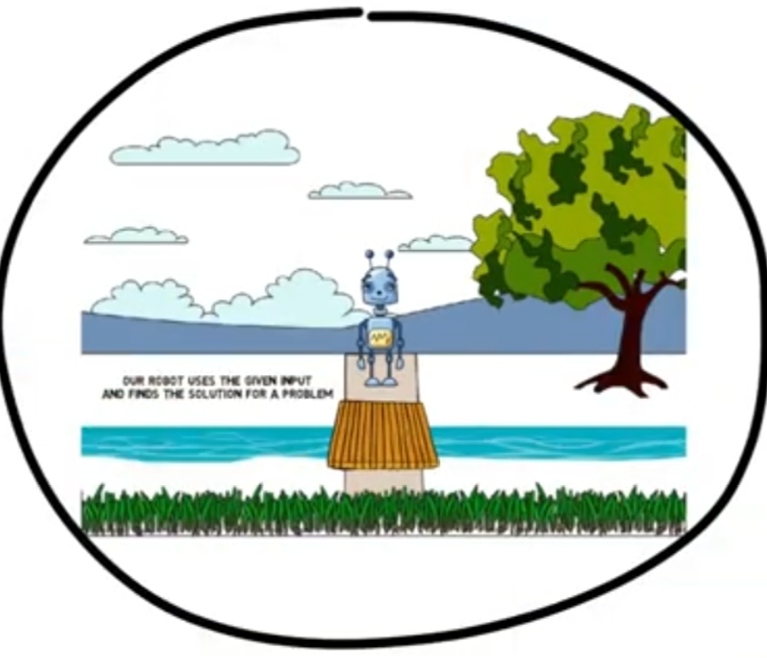
What Does AI Do at its Core?
Problem Solving

Slide 14
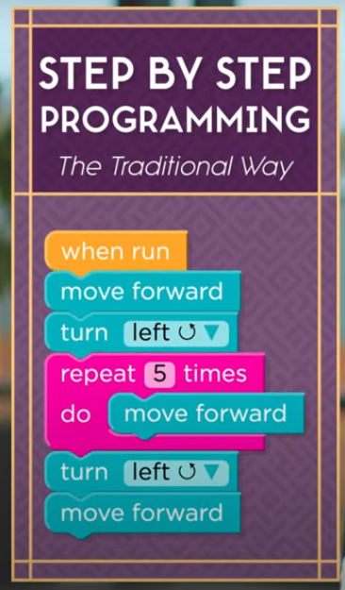
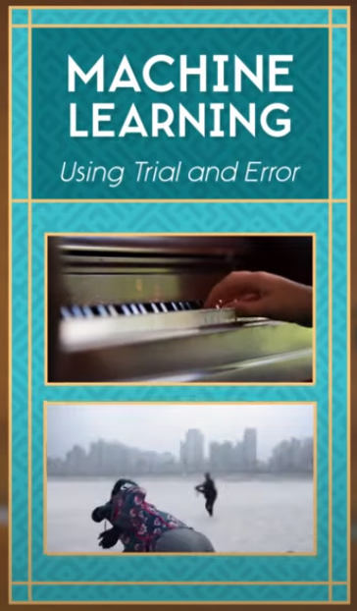
What Is Machine Learning?
How computers recognize patterns and make decisions without being explicitly programmed?
With Machine Learning, instead of programming your computer step by step, we can program our computer just like Human with trial and error and lots of practice
To recognize pattern in that data, we need machines to make Predictions

Slide 15
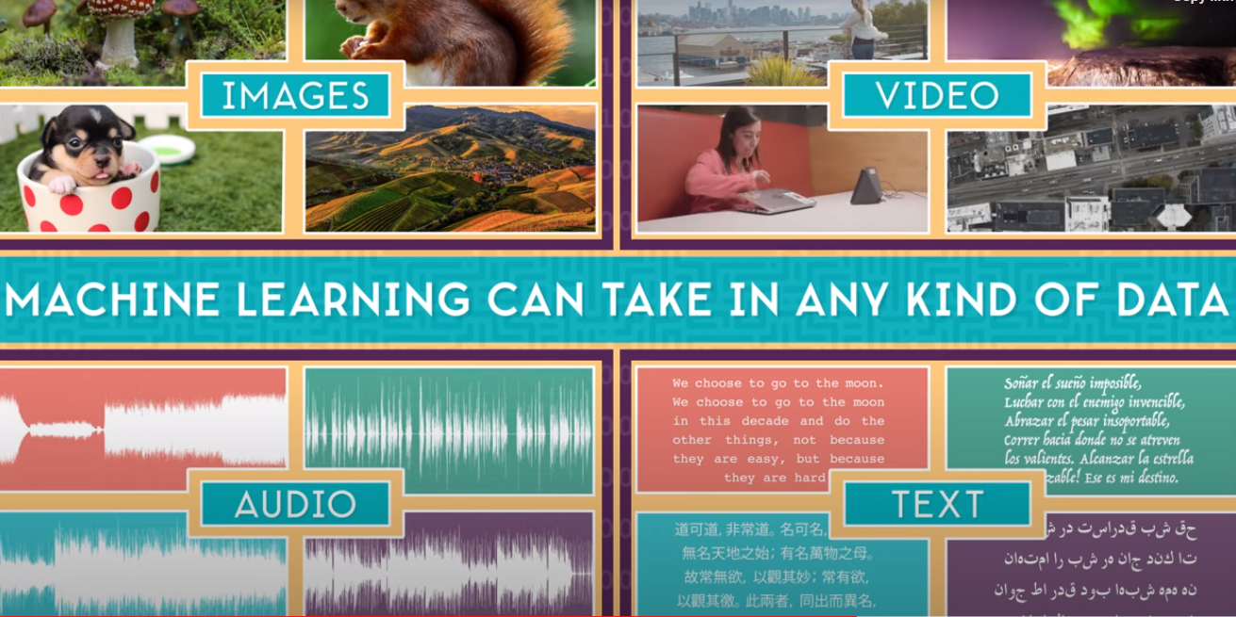
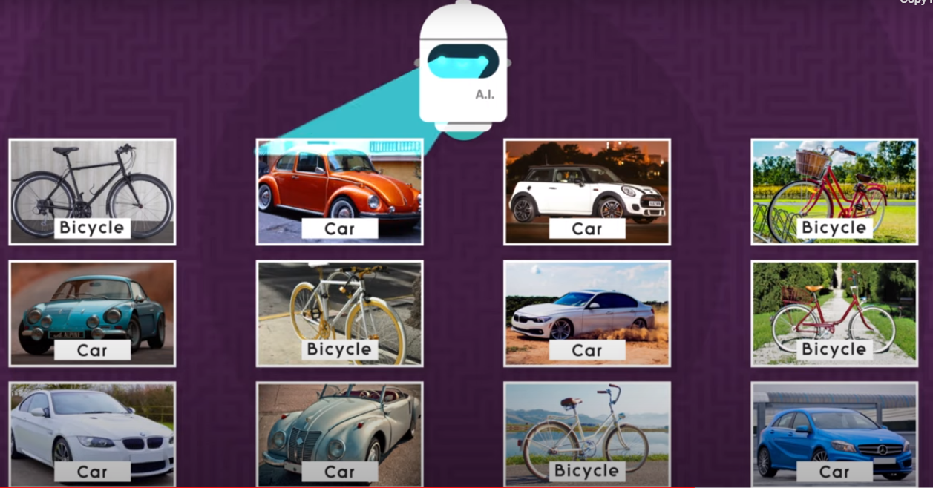
What Is Machine Learning?
Learning comes from experience and that’s true for Machine Learning too
In this case, ‘Experience’ means lots and lots of Data
ML can take in any kind of Data such as, videos, images, texts or Audio and recognizes pattern in that data

Slide 16


Training Data…
You basically help the Machine with the training data to learn and see and drive a car
Medical Researchers can use medical data as training data to teach computers how to recognize and diagnose diseases
Machine Learning means 1000s of images and training directions from doctors who knows what to look for before correctly identifying any diseases
Select All the Street Signs

Slide 17
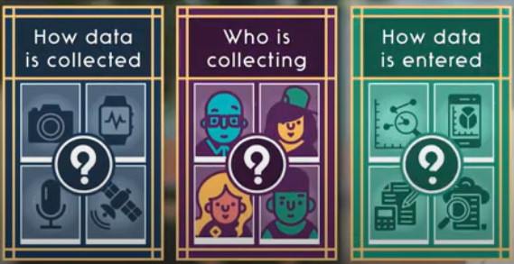
Bias…
“Bias in AI” refers to situations where machine learning-based data analytics systems discriminate against particular groups of people
This discrimination usually follows our own societal biases regarding race, gender, biological sex, nationality, or age
The better the Data you provide the better the computer will learn

Slide 18
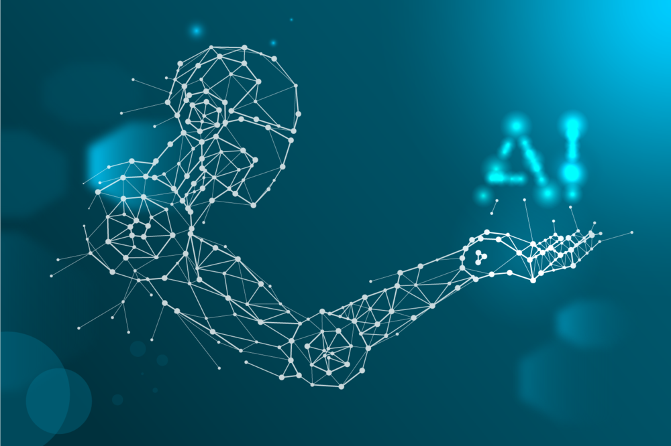

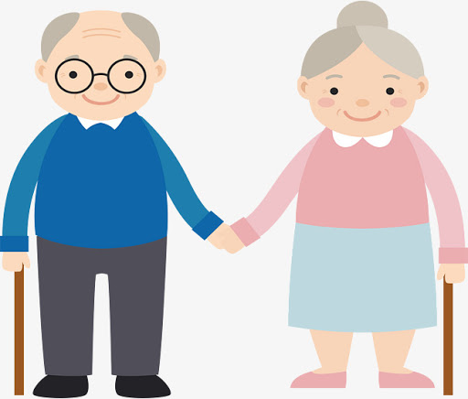

Future of AI…
Automated Transportation will become a common thing in the future
Robots will take over hazardous jobs like bomb diffusing
In Future, Humans will be able to augment themselves with Robots
‘Home Robots’ will help elderly with their day to day work
There will be more numbers of smart cities as vehicles,Phones,Home Appliances will be run by AI

Slide 19
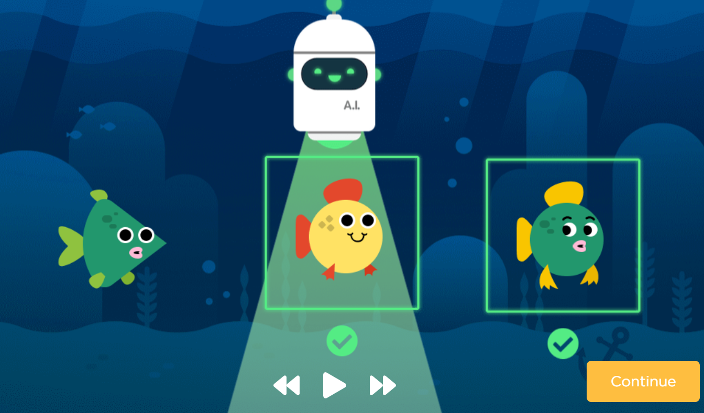
Activity – AI Of Oceans…
With “AI for Oceans” activity, you will train real machine learning models
Imagine an ocean that contains creatures like fish and trash
You will explore how training data is used to enable a machine learning model to classify new data
Then, you will need to expand the training data set to include other sea creatures
Visit https://code.org/oceans

Slide 20
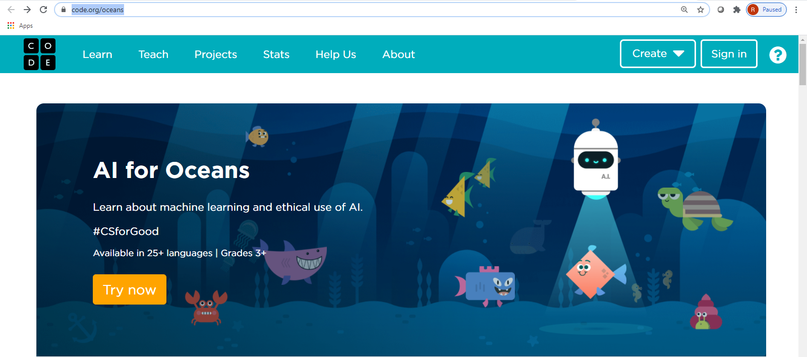
Activity – AI Of Oceans…

Slide 21
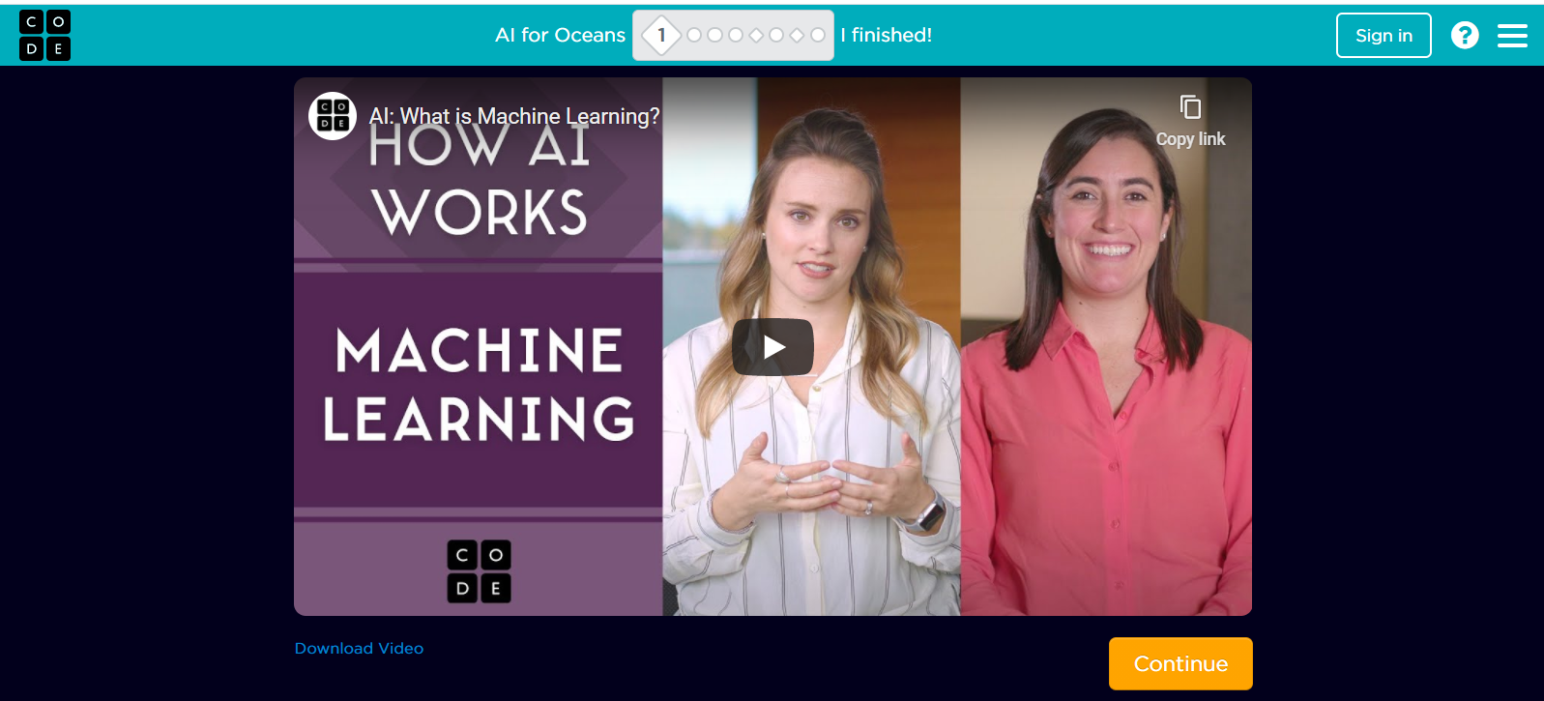
Activity – AI Of Oceans…

Slide 22
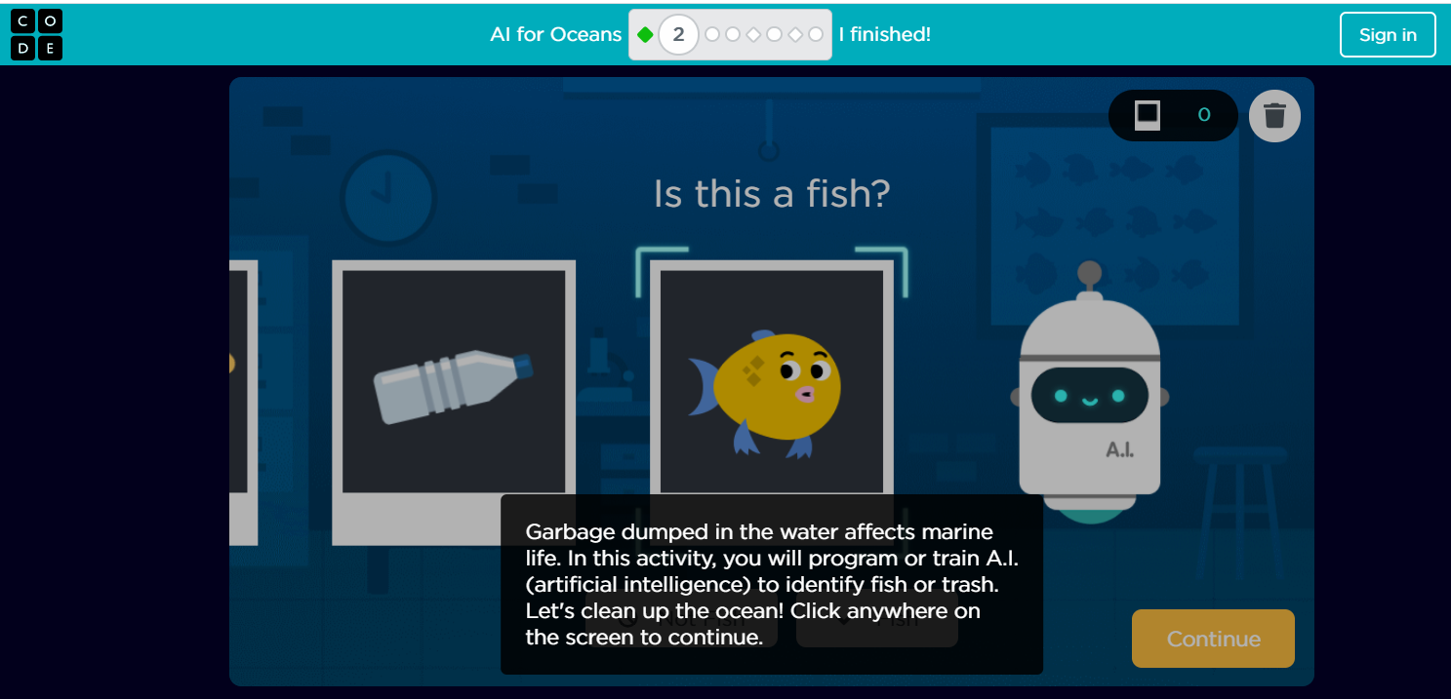
Activity – AI Of Oceans…

Slide 23
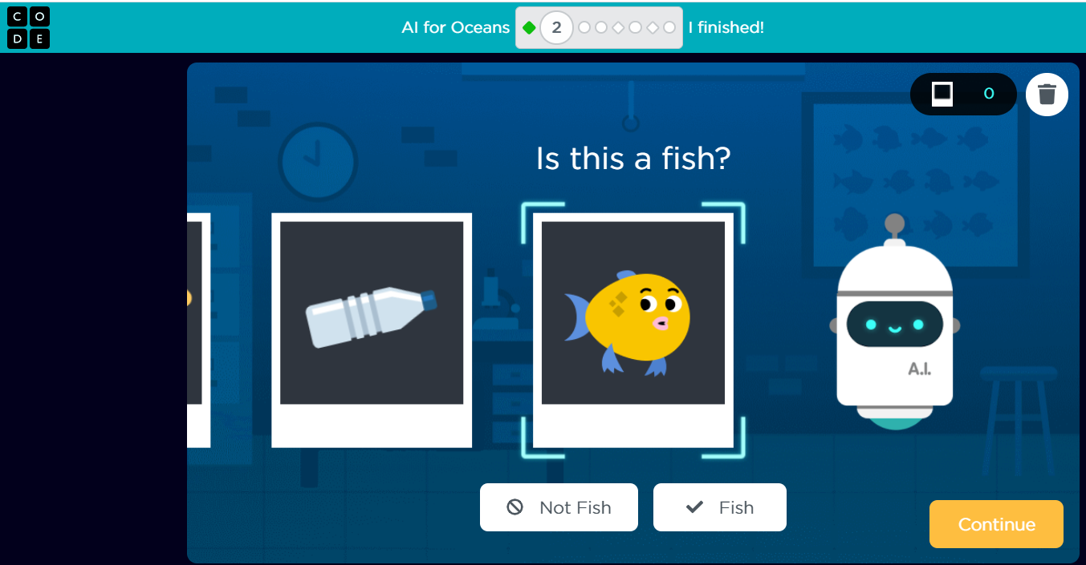
Activity – AI Of Oceans…

Slide 24

Summary…
Understanding AI?
Machine Learning
AI Training?
AI Applications

Slide 25

Next Session…
Cloud Database:
What is Database
What is Table & Record
Understanding Cloud Database

